Slide 1
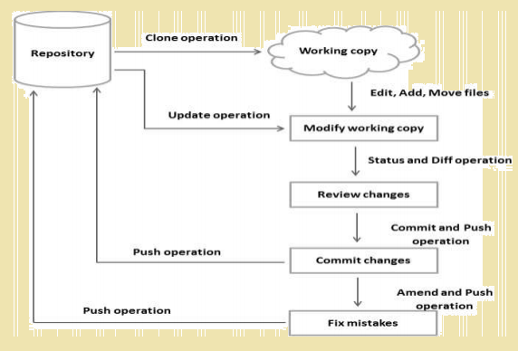
Git General Workflow

Slide 2
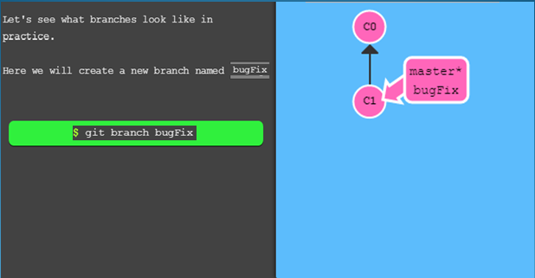
Create New Branch

Slide 3
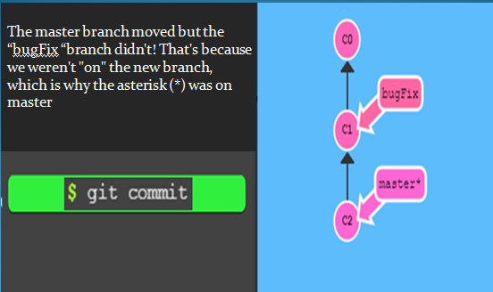
Git Commit

Slide 4

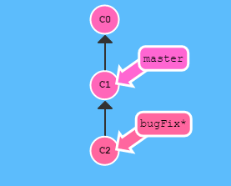
Let’s checkout New Branch and commit
Developers can start enhancement / bug fixing in new branch

Slide 5
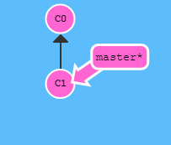
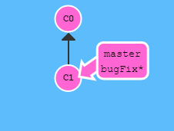
Create New Branch and Checkout at the same time

Slide 6
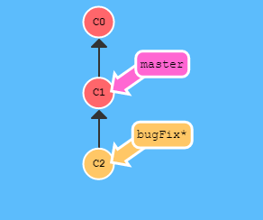

Commit

Slide 7
Branches and Merging
Now we will combine the work from two different branches together. This will allow us to branch off, develop a new feature, and then combine it back in.
The first method to combine work that we will examine is ”git merge”. Merging in Git creates a special commit that has two unique parents. A commit with two parents essentially means "I want to include all the work from this parent over here and this one over here, and the set of all their parents.“

Slide 8
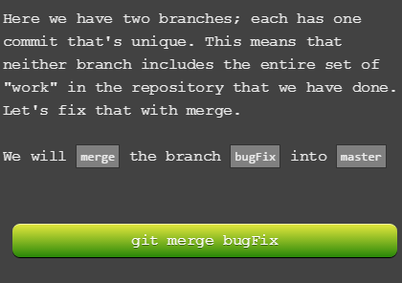
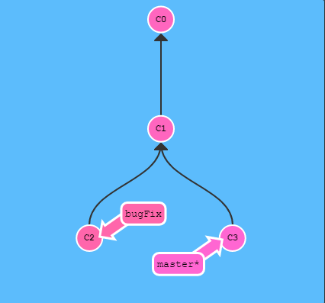
Merging Branch

Slide 9
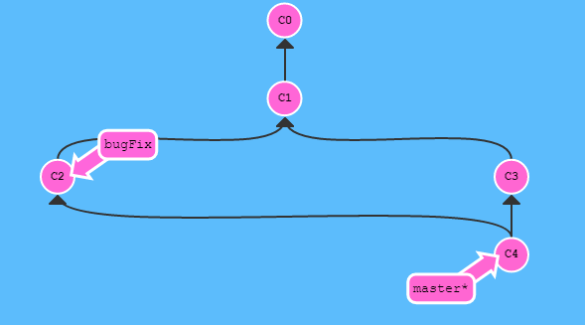
Merging Branch
See that? First of all, master now points to a commit that has two parents. If you follow the arrows up the commit tree from master, you will hit every commit along the way to the root. This means that master contains all the work in the repository now.

Slide 10
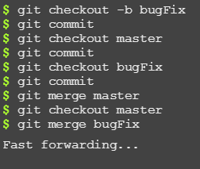
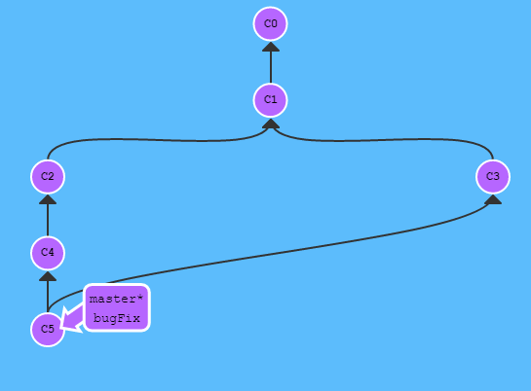
Merging Branch correct way

Slide 11
Git Rebase
The second way of combining work between branches is rebasing. Rebasing essentially takes a set of commits, "copies" them, and plops them down somewhere else.
While this sounds confusing, the advantage of rebasing is that it can be used to make a nice linear sequence of commits. The commit log / history of the repository will be a lot cleaner if only rebasing is allowed.

Slide 12
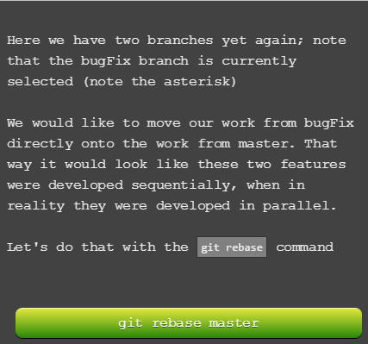
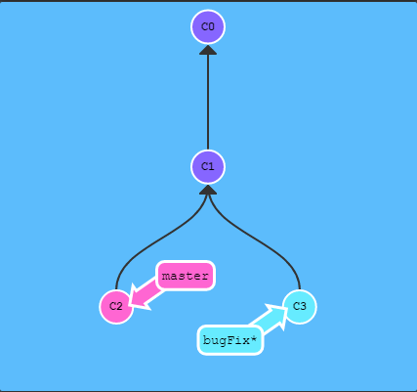
Git Rebase

Slide 13
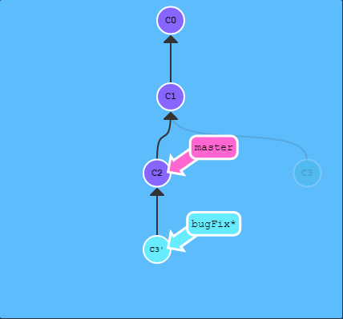
Git Rebase

Slide 14
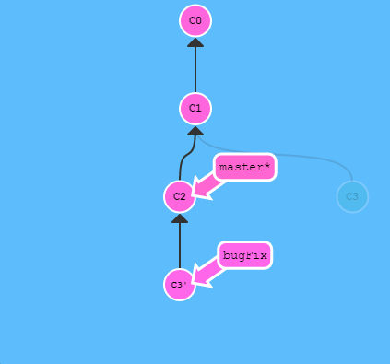
Git Rebase

Slide 15
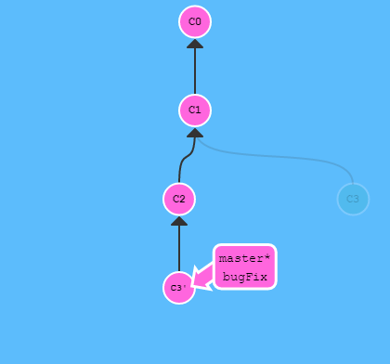

Git Rebase

Slide 16
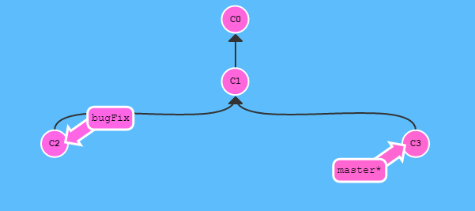
Deleting Branch

Slide 17
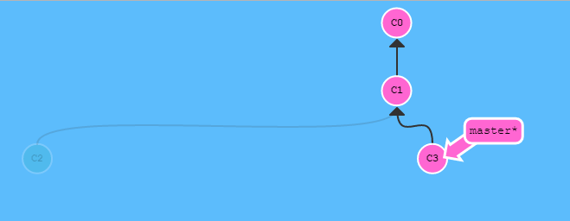
Deleting Branch
$ git branch -d bugFix

Slide 18

??????????????

Slide 19

Learn Git
https://confluence.ba.ssa.gov/display/MDE/Git+Tutorial+Series
http://learngitbranching.js.org/

